Slide 1
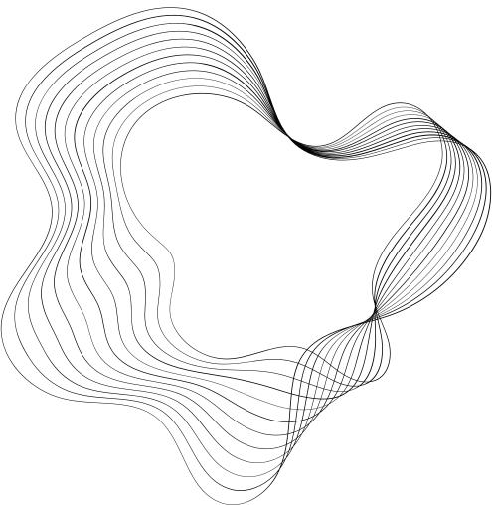

GIFS CONTENT RATING
PROJECT
BY: HANAN WULLMAN, YOTAM ZVIELI AND ASAF BEN-SHAUL

Slide 2
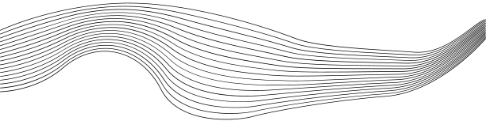
CONTENT
01
PROBLEM DEFINITION
02
DATASET
03
SOLUTIONS WE CONSIDERED
04
OUR SOLUTION
05
DEMO
06
HOW TO IMPROVE?
07
WHAT NEXT?

Slide 3
PROBLEM DEFINITION
The internet contains vast unsupervised content, exposing users to inappropriate material, especially children
Our goal: Classify GIFs into 'appropriate' or 'inappropriate' categories to ensure safer digital spaces

Slide 4
DATASET
Source: GIPHY public API
Content ratings: G, PG, PG-13, R
We combined the data into ‘Appropriate’ and ‘Inappropriate’ classes
We downloaded around 7K gifs.
Incosistent classification, manual filtering was needed

Slide 5
ALONG THE PATH WE TRIED
Custom model from scratch
Pretrained models: GIFs => text => class
Pretrained model: GIFs => class

Slide 6
OUR SOLUTION
Embeddings from pretrained image model
Custom model for binary classification
Input gif
Embeddings modal
Custom modal
Prediction

Slide 7
PRE TRAINED MODEL
ViT-B-16
Architecture: Transformer adapted for image processing
Size: Medium, ~86M parameters.
Pretraining: Trained on large datasets. (we used laion2b_s34b_b88k)
Use: Strong in classification and vision tasks.

Slide 8
input dim = size of embeddings given by modal * num frames
OUR MODEL
fully connected linear layer that maps to a hidden dimension
X
parameters
Residual Block
Loss Function=CrossEntropyLoss
Num_Frames=30
Learn Rate - 8e-7
Epochs= min(100, crosses 80% accuracy)
Batch_size=8
Hidden Dim =1024
Num Residual Blocks =10
Dropout_prob=0.4
Size of embeddings given by modal= 512
fully connected linear layer
Batch normalization
Residual Block
Activation function (LeakyReLU)
........
Dropout
fully connected linear layer that maps to a output dimension
F(X)+x
output (dim=2)

Slide 9

DEMO

Slide 10
HOW TO IMPROVE
Expend dataset
Enhancing the model architecthture
Fine-Tuning the Pretrained Model

Slide 11
WHAT NEXT?

Slide 12

THANK'S FOR WATCHING

